Slide 1
Trigonometry
Objective: to be able to calculate a missing angle of a right angled triangle using a given angle and side (Grade B)
By the end of the lesson:
All: will be to identify whether to use sin, cos or tan to find a missing angle
Most: will be able to calculate a missing angle using sin, cos or tan
Some: will be to answer missing angle problems

Slide 2
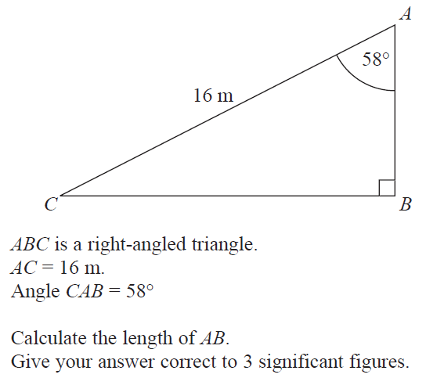
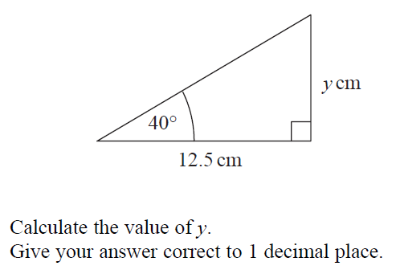
Starter
y = 10.48874539 cm
y = 10.5 cm
AB = 8.478708228 m
AB = 8.48 m

Slide 3
24
7
30
Date
Finding a Missing Angle
EQ – How do you find the size of a missing angle and which trig ratio do you use?
Hypotenuse
Opposite
ϴ
Adjacent
5

Slide 4
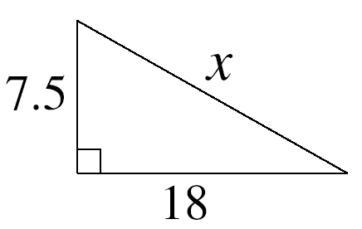
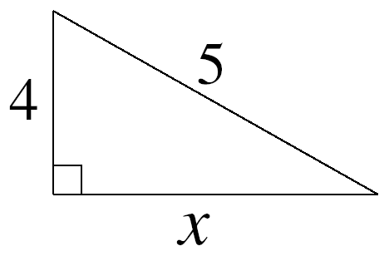
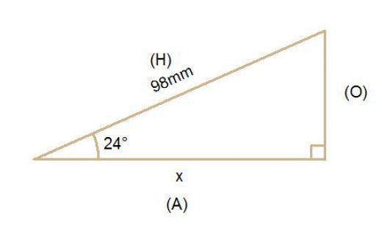
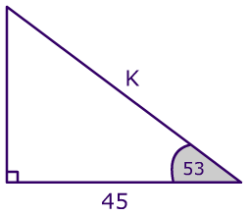
What do we already know
Find a missing side, given 2 sides – we use Pythagoras
Find a missing side, given an angle and 1 side – we use Trigonometry

Slide 5
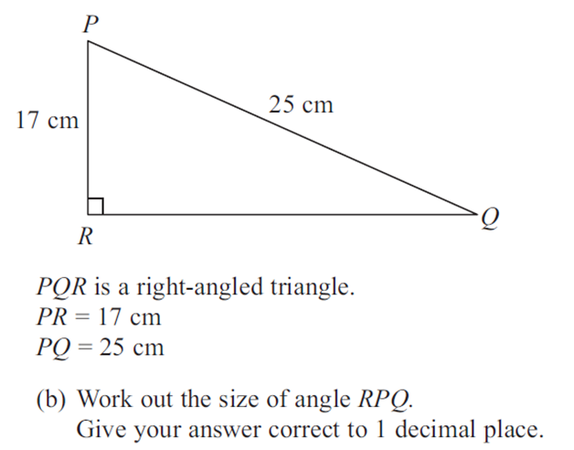
What about?
When we are given a situation when we need to find a missing angle
We need to extend what we know to answer this

Slide 6
Inverse Operations
The inverse of × is ÷
The inverse of + is -
The inverse of x² is √x
So, what is the inverse of sin, cos and tan?
Look on your calculator!

Slide 7
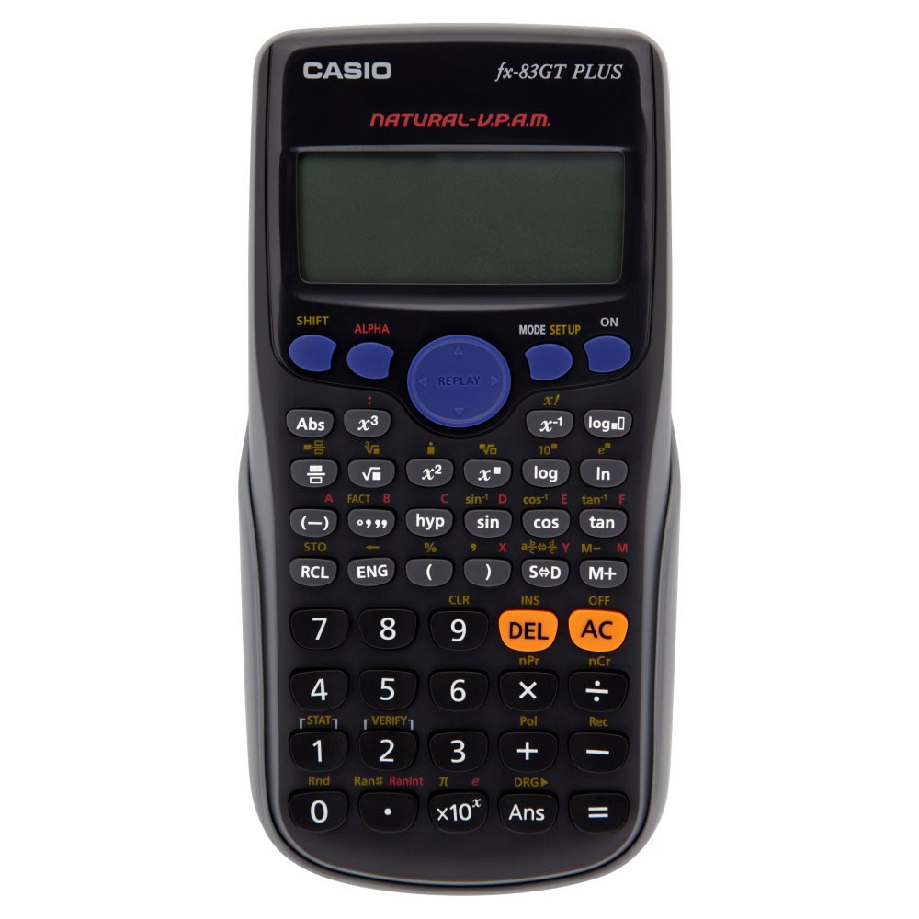
The inverse of
sin is written in
yellow above
What would I press to get the inverse of sin on my calculator?

Slide 8






Inverse Operations
The inverse of is
The inverse of is
The inverse of is

Slide 9
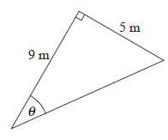





Calculating a missing angle
Find the size of the angle Θ. Round to 1 decimal place
O
A
H

Slide 10





Calculating a missing angle

Slide 11
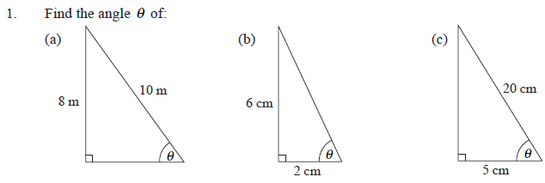






Draw these into your books and calculate the value of Θ
Round the answers to 1 decimal place

Slide 12
Task 1 – Calculating missing angles
On the worksheet – calculate the following missing angles using trigonometry
Extension
Worksheet – give answers to 1 decimal place

Slide 13
Task 1 - Solutions
1)
a = 46.2º
b = 19.7º
c = 37.7º
d = 43.6º
e = 53.3º
f = 60.4º
2)
a = 23.6º
b = 66.4º
Extension
1)
a = 14.5º
b = 45.5º
c = 23.8º
2) 60º
3) 11.5º

Slide 14
Task 2 – Past GCSE Questions
Complete the following past GCSE questions
There are green, amber and red sections

Slide 15


Task 2 – Solutions
Green
Amber
Red
x = 51.31781255º
x = 51.3º (1 d.p.)
y = 34.82448916º
y = 34.8º (1 d.p.)
x = 28.07248694º
x = 28.1º (3 s.f.)
RPQ = 21.801409..º
RPQ = 21.8º (3 s.f)
x = 39.32308918º
x = 39.3º (3 s.f.)
CD =2.734499693
x = 77.2º (1 d.p.)

Slide 16
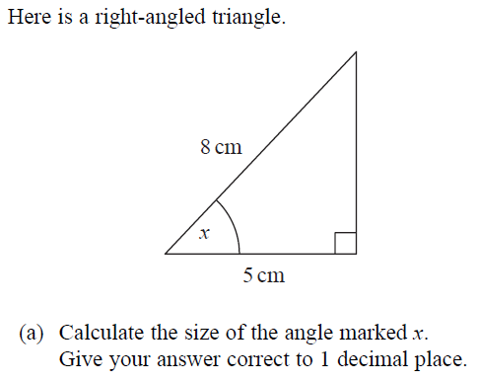
Green 1

Slide 17
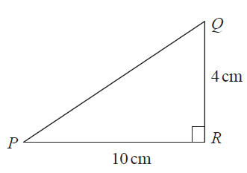
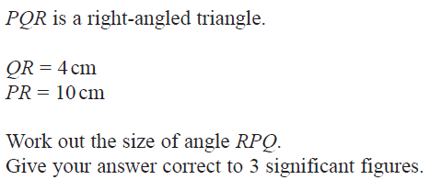
Green 2

Slide 18
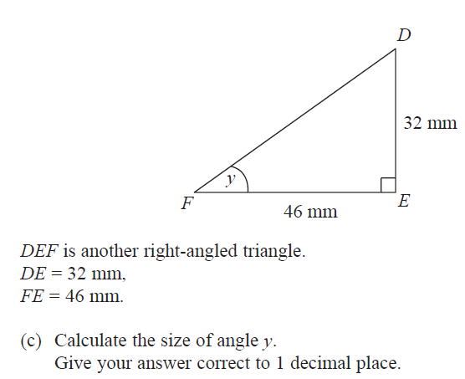
Amber 1

Slide 19
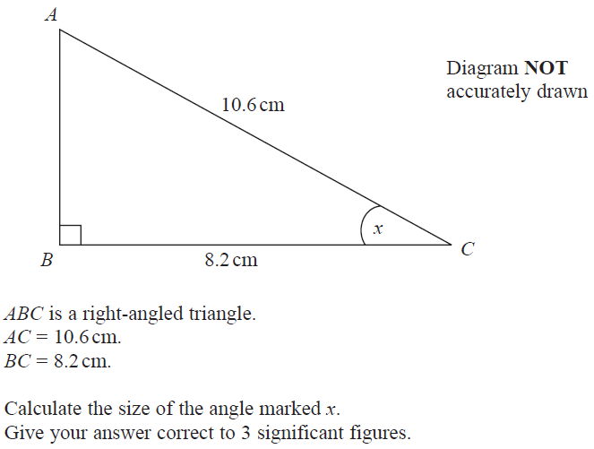
Amber 2

Slide 20
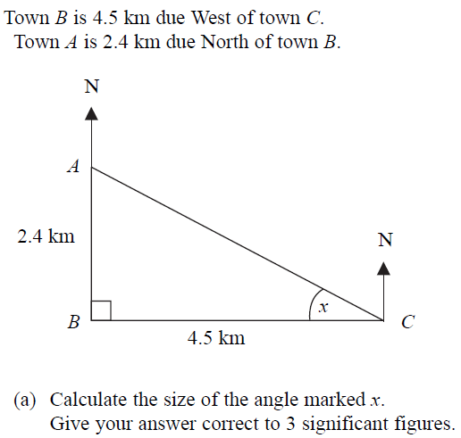
Red 1

Slide 21
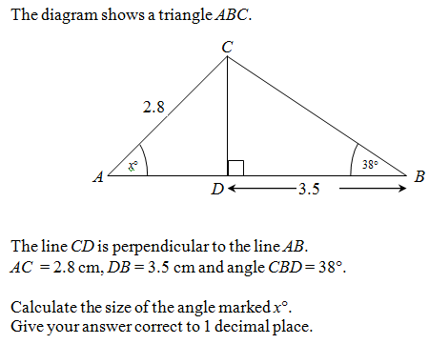
Red 2

Slide 22
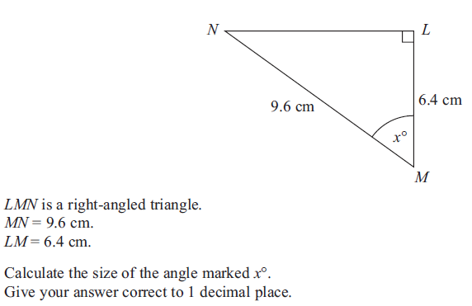
To Finish - June 2012

Slide 23
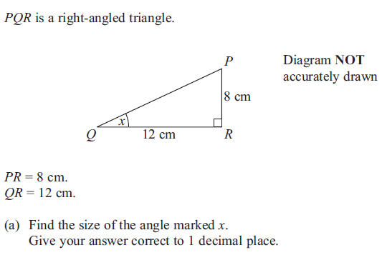
To Finish - March 2012

